Slide 1


Slide 2


Slide 3
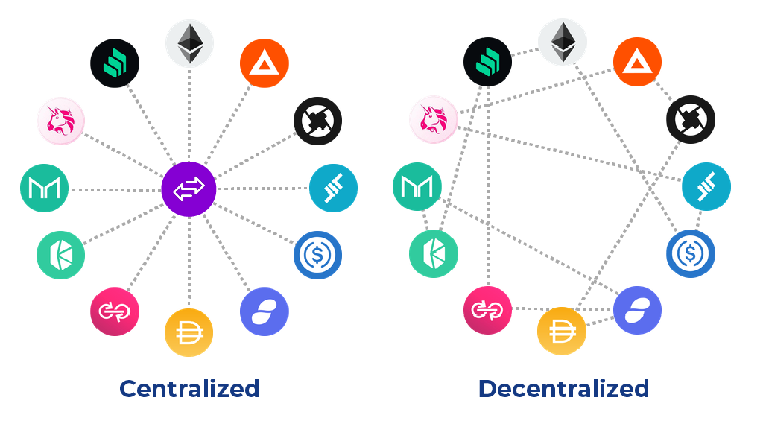
Centralised
Decentralised
Custodians of funds
Orderbook system
Know Your Customer (KYC)
Central body replaced with smart contract/code
Orderbook replaced with AMM
Do not require KYC
Tokens traded must be on same blockchain
Little support

Slide 4
COSTS ON DEXs
Orderbook replaced with automated market maker (AMM)
DEX keeps balance of liquidity between each trading pair
Price impact determined by the ‘buy’ amount and the effect it has on the liquidity of the token on the exchange.
Blockchain transaction fees – fee to use the network
Slippage cost - the percentage amount that the purchaser chooses to potentially pay over their asking price to ensure their trade goes through

